Slide 1
Lecture 6: Rigid Motion and Relations to Using Quaternions
Math 142
Prof. Gu

Slide 2
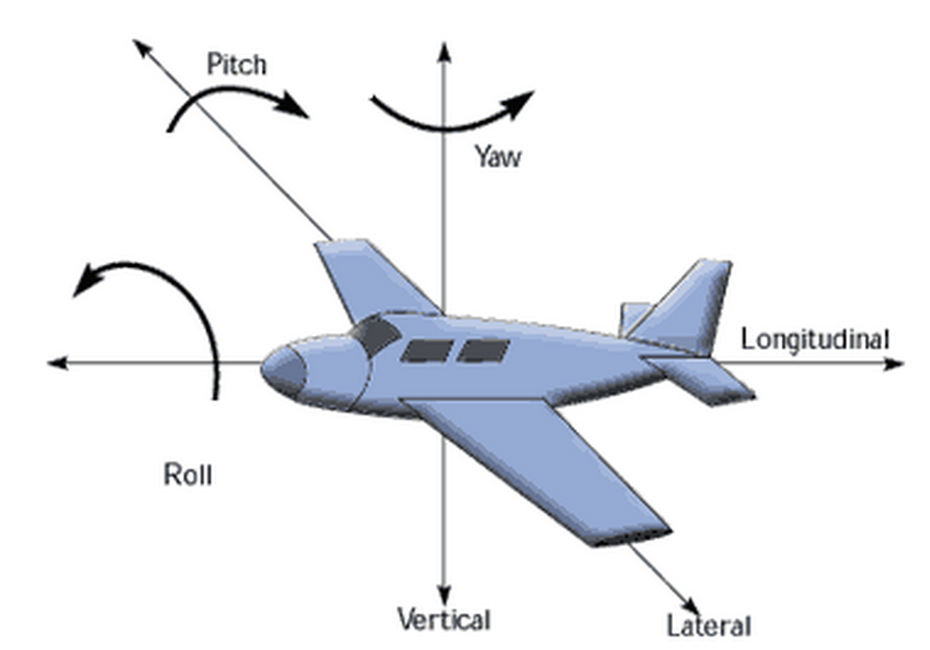
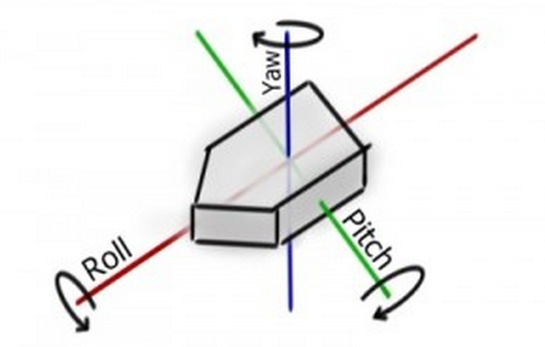
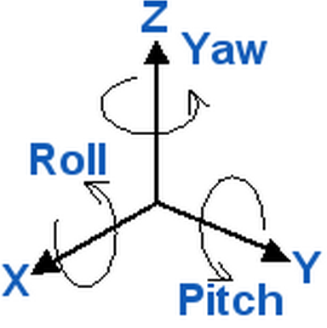
Key: We view that there is a frame attached to an airplane or to a rigid body. When the airplane is flying or the rigid body is moving, we only need to record how the frame is moving. Why? Since any other point on the body can be written as a linear combination using the 3 frame vectors as bases. Note: the coefficients in this linear combination for that point would not change when the frame is moving since the body is rigid .
Key: Reduce the problem to understanding only how the frame is moving.

Slide 3
We use an orthogonal matrix to represent an orthonormal 3-frame
Each column is a vector in the 3-frame.
We consider all such possible frames, i.e. all possible orthonormal matrices. It can be proved that they form a group under multiplication. Denoted by SO(3).
In fact, it can be proved in the future that SO(3) is also a manifold.
A group “+” manifold = a Lie group
SO(3) is a Lie group.

Slide 4
Rigid Motions
Rotation “+” translation
Rotation and translation are not commute; but there is formula to describe the difference.
So the product is a “semi” product.
More details can be found in my lecture notes.
Recall, we have O(n) and SO(n). In corresponding we have E(n) and SE(n).
E(n) = O(n) “+” R³
SE(n) = SO(n) “+” R³

Slide 5
Please see my detailed lecture notes on Rigid Motion and Mirror Reflection
Work details on the board with the students.

Slide 6
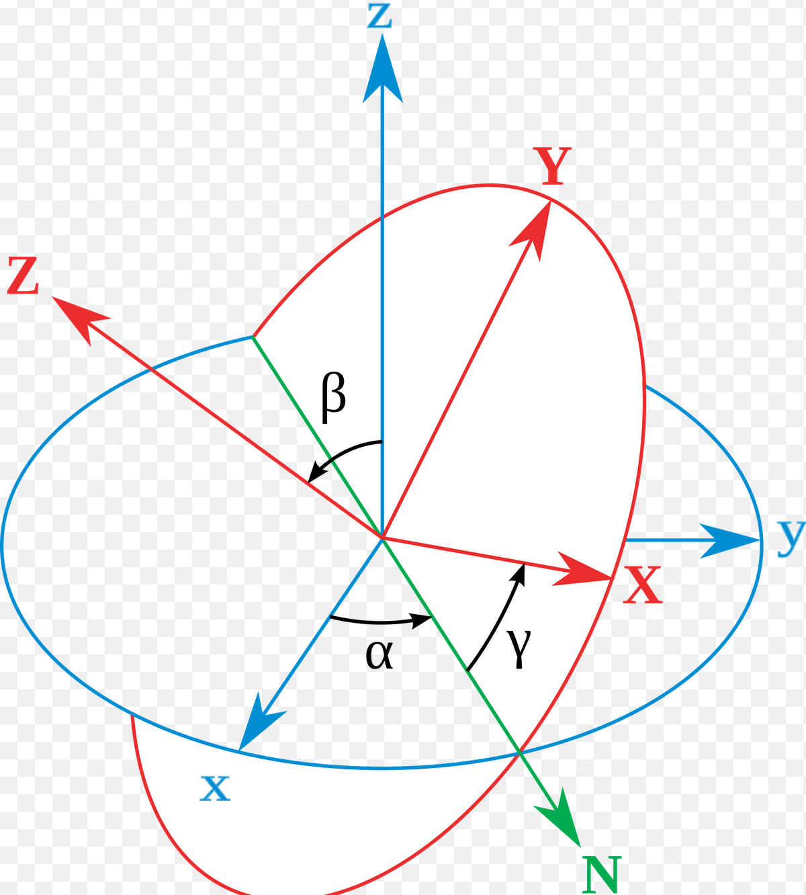
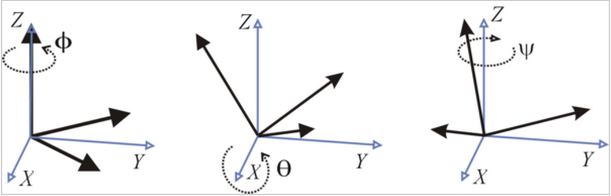
Euler Angles
The Euler angles are three angles introduced by Leonhard Euler to describe the orientation of a rigid body. To describe such an orientation in 3-dimensional Euclidean space three parameters are required.
Please see details at:
https://en.wikipedia.org/wiki/Euler_angles

Slide 7
Gimbal Lock Please watch the video below!
https://www.youtube.com/watch?v=zc8b2Jo7mno

Slide 8
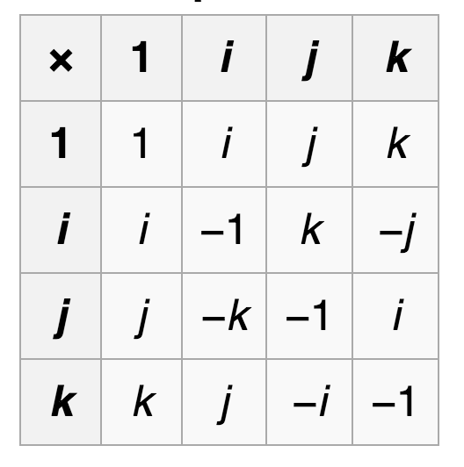
We can avoid Gimbal Lock using Quaternion multiplications
Recall: the quaternion are set of a + bi + cj + dk where a, b, c, and d are real. Two quaternions can be multiplied using the table below:
Please see more details on quaternions:
https://en.wikipedia.org/wiki/Quaternion

Slide 9
Recall: We try to use a unit quaternion to define a rotation in R³
We first defined a map:
R_{q}(p) = qpq⁻¹
2. In order to show R is a rotation, let us first show the following (First Recall when a linear map is an orthogonal map):
R keeps the length.
R is linear.
Q: What else we must show? Why can’t we define a rotation as R_{q}(p) = qp?
Note: For unit quaternion q,
Inverse (q) = conjugate (q).
Why?

